Slide 1
Advanced Dungeons and Testing Dragons
Temple of the Golden Cobra
SLIDES: https://goo.gl/56EJwk

Slide 2

Franklin Webber
Training and Technical Content Lead
US Army - Radio/COMSEC Repairer (35E)
Tech Support
Quality Assurance
Software Developer Eng. in Test
Software Developer
Instructor / Trainer
Notes:
Before we start let me introduce myself.

Slide 3




Dan
"Two Swords" Robinson
Eric
"BB / LG" Maxwell
Kimball
"Magic Missile" Johnson
Tyler
"Cure Light Wounds"
Fitch

Slide 4
You
Level 4-6 Chef Cookbook Author
High Charisma
Understand Chef Resources, Cookbooks, and Cookbook dependencies
Understanding testing basics (i.e. ChefSpec and the RSpec command)
Notes:
Let me tell who I think you are and for whom this content has been designed.

Slide 5
Introduce Yourself
Name
Where you work
The Best Part of Your Job
The Most Difficult Part of Your Job
A Favorite Hobby or Past time as a Child
What You Want to get out of ChefConf

Slide 6
Schedule
9:00 - 9:30 – Introductions
9:30 - 10:20 – Finding the Ark
10:20 - 10:30 – BREAK
10:30 - 11:20 – Unraveling the Power of the Ark
11:20 - 11:30 – BREAK
11:30 - 12:20 – The Ark's Power Realized
12:20 - 13:45 – LUNCH
Notes:
This is the workshop schedule.

Slide 7
Schedule
12:20 - 13:45 – LUNCH
13:45 - 14:35 – The Python's Scales
14:35 - 14:45 – BREAK
14:45 - 15:35 – Challenging the Golden Cobra
15:35 - 15:45 – BREAK
15:45 - 16:35 – Securing the Power of the Ark
16:35 - 16:45 – GOODBYES
Notes:
This is the workshop schedule.

Slide 8
Scenario Agenda
Introduction (3 minutes)
D&D flavored introduction
The Encounter (8 minutes)
Outline the problem that you are going to face
Concepts (10 minutes)
Define the tools and techniques you are going to use to solve the problem
Exercise (20 minutes)
Give you time to solve the problem with the support of us and the party
Review (10 minutes)
Demonstration and Review the techniques and answer questions
Notes:
davidd @ https://flic.kr/p/DyTeW1

Slide 9


Slide 10
Locally
Remotely
Clone or download the following Repository:
github.com
chef-training/atdt-chefconf_2016
Login to the a remote workstation:
url: https://goo.gl/jfUUtL
user: chef
password: chef

Slide 11
Advanced Dungeons and Testing Dragons
Temple of the Golden Cobra
SLIDES: https://goo.gl/56EJwk

Slide 12
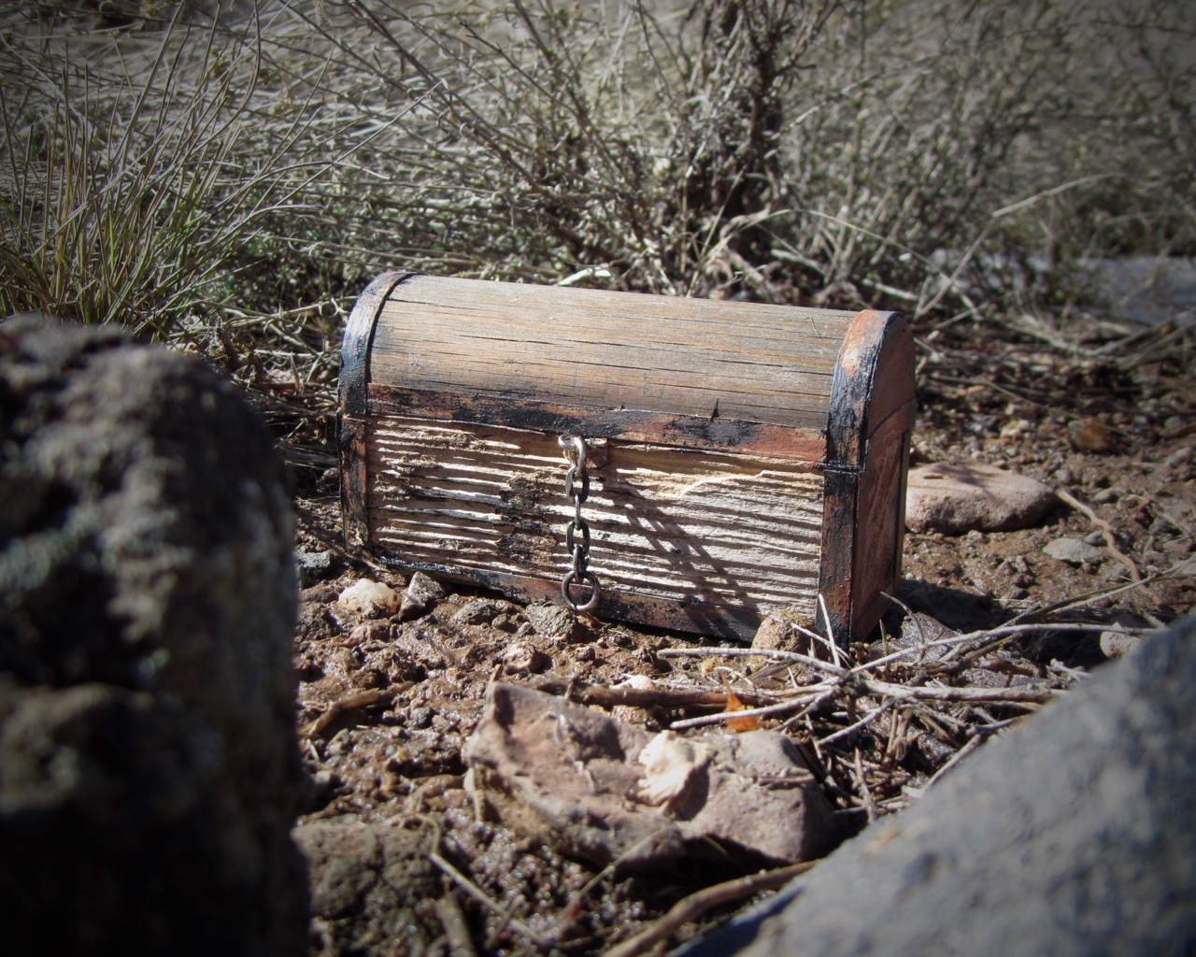
Finding the Ark
Introduction
The Encounter
Concepts
Exercise
Review
Notes:
davidd @ https://flic.kr/p/DyTeW1

Slide 13
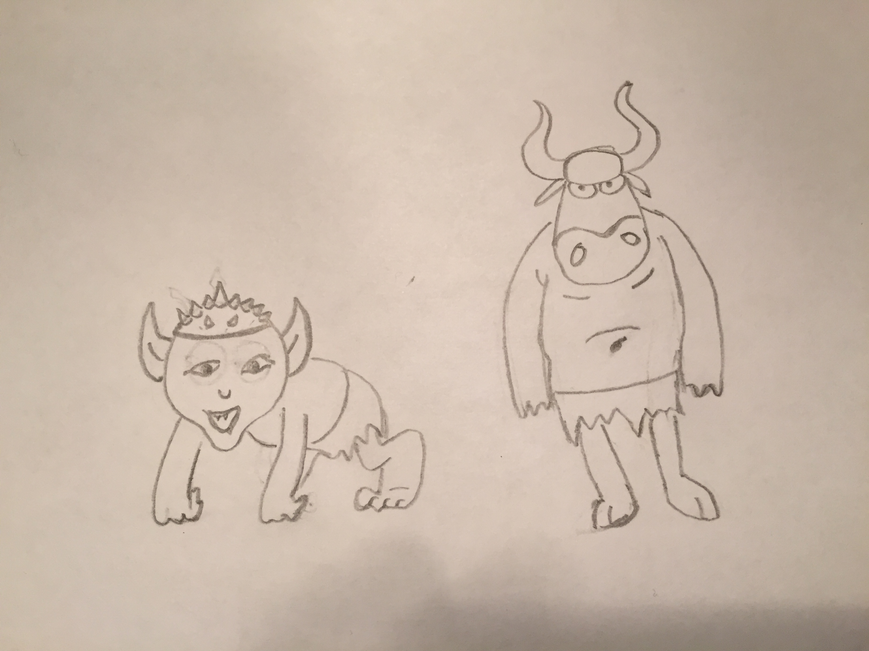
Notes:
The musty crypt takes on a rancid odor as you descend into lower catacombs. Around each bend and curve of the hand carved caves lie shelves housing the bones of the monks that were once ceremonially buried below. Several of the open graves are overturned and the bones are spilled and scattered to the floor.
The dark passage leads further down into what you hope will be the chamber. The graves along the walls are far less molested here in this area. But you do find smaller bones scattered and spread along the floor. Near the bones the refuse of some creature or creatures. The obvious reason for the foul stench that fills the cavity you are now trespassing through.
Out of the darkness you suddenly hear the screeches and snarls. Your light spell, torch, or low-light vision show that you have stumbled upon a band of goblins standing around the Ark you have been searching for. None of them smart enough to know how to use it and you hope in a few moments far less of them so they aren't able to transport it.

Slide 14
Finding the Ark
Introduction
The Encounter
Concepts
Exercise
Review

Slide 15
Changing into the Cookbook Directory
> cd ~/ark

Slide 16
Executing the Test Suite
> chef exec rspec spec/unit/recipes/default_spec.rb
...................
Finished in 3.58 seconds (files took 2.73 seconds to load)
19 examples, 0 failures
ChefSpec Coverage report generated...
Total Resources: 41
Touched Resources: 41
Touch Coverage: 100.0%

Slide 17
Viewing the Recipe Specification
~/ark/spec/unit/recipes/default_spec.rb
require 'spec_helper'
describe 'ark::default' do
context 'when no attributes are specified, on an unspe...orm' do
let(:chef_run) do
runner = ChefSpec::SoloRunner.new
runner.converge(described_recipe)
end
it 'installs necessary packages' do

Slide 18
Redundancy in the Test Suite
As a test suite grows in size and complexity it becomes more difficult to read and maintain.
This will ultimately make it more difficult to make changes to the cookbook as you will often times fight with the specifications more often than writing the code that will deliver value to the goals of our organization.
Adventurers, your goal is to reduce the size and complexity of this test file.

Slide 19
Finding the Ark
Introduction
The Encounter
Concepts
Exercise
Review

Slide 20
Power Word: let
Use let to define a memoized helper method. The value will be cached
across multiple calls in the same example but not across examples.
Note that let is lazy-evaluated: it is not evaluated until the first time
the method it defines is invoked. You can use let! to force the method's
invocation before each example.
https://goo.gl/BJp0IQ

Slide 21
Diagramming the let Helper Method
describe 'ark::default' do
context 'when no attributes are ...
let(:chef_run) do
runner = ChefSpec::SoloRunner.new
runner.converge(described_recipe)
runner
end
it 'installs necessary packages' do
expect(chef_run).to install_p...
expect(chef_run).to install_p...
end
it "does not install the gcc-c+...
expect(chef_run).not_to insta...
end
2
1
3
4
1
let is a RSpec helper method
Ruby Symbol
Code Block
Invocation
2
3
4

Slide 22
Invoking the Helper Method
describe 'ark::default' do
context 'when no attributes are ...
let(:chef_run) do
runner = ChefSpec::SoloRunner.new
runner.converge(described_recipe)
runner
end
it 'installs necessary packages' do
expect(chef_run).to install_p...
expect(chef_run).to install_p...
end
it "does not install the gcc-c+...
expect(chef_run).not_to insta...
end
chef_run sends a message
RSpec invokes the contents of the block
RSpec stores the contents of the execution
chef_run sends a message
RSpec retrieves the stored execution
1
2
2
3
1
4
5
4

Slide 23
Cached Within each Example
describe 'ark::default' do
context 'when no attributes are ...
let(:chef_run) do
runner = ChefSpec::SoloRunner.new
runner.converge(described_recipe)
runner
end
it 'installs necessary packages' do
expect(chef_run).to install_p...
expect(chef_run).to install_p...
end
it "does not install the gcc-c+...
expect(chef_run).not_to insta...
end
chef_run is loaded and stored
chef_run uses the stored invocation
chef_run is loaded and stored
1
2
3
1
2
3

Slide 24
A chef_run with Node Attributes
describe 'ark::default' do
context 'when no attributes are specified, on CentOS' do
let(:chef_run) do
runner = ChefSpec::SoloRunner.new({ platform: 'centos',
version: '6.7' })
runner.converge(described_recipe)
end
# ... EXAMPLES WITHIN CONTEXT
end
end

Slide 25
Using let to Create Clearer Examples
describe 'ark::default' do
context 'when no attributes are specified, on CentOS' do
let(:chef_run) do
runner = ChefSpec::SoloRunner.new(node_attributes)
runner.converge(described_recipe)
end
let(:node_attributes) do
{ platform: 'centos', version: '6.7' }
end
# ... EXAMPLES WITHIN CONTEXT
end

Slide 26
A let for each Context
describe 'ark::default' do
context 'when no attributes are specified, on an unspecifed ...orm' do
let(:chef_run) do
runner = ChefSpec::SoloRunner.new
runner.converge(described_recipe)
end
# ... EXAMPLES WITHIN CONTEXT
end
context 'when no attributes are specified, on CentOS' do
let(:chef_run) do
runner = ChefSpec::SoloRunner.new(platform: 'centos', version: ...)
runner.converge(described_recipe)
end
# ... EXAMPLES WITHIN CONTEXT

Slide 27
Overriding a let in a Child Context
describe 'ark::default' do
let(:chef_run) do
runner = ChefSpec::SoloRunner.new(node_attributes)
runner.converge(described_recipe)
end
let(:node_attributes) do
{}
end
context 'when no attributes are specified, on an unspecif...orm' do
# ... EXAMPLES WITHIN CONTEXT
end
context 'when no attributes are specified, on CentOS' do
let(:node_attributes) do
{ platform: 'centos', version: '6.7' }
end
# ... EXAMPLES WITHIN CONTEXT

Slide 28
Conjure shared_examples
Shared examples let you describe behavior of classes or modules. When declared, a shared group's content is stored. It is only realized in the context of another example group, which provides any context the shared group needs to run.
https://goo.gl/yi12tM

Slide 29
Finding Similar Expressed Expectations
context 'when no attributes are specified, on an unspecif...orm' do
# let(:installed_packages) ...
it 'installs the necessary packages' do
installed_packages.each do |name|
expect(chef_run).to install_package(name)
end
end
end
context 'when no attributes are specified, on CentOS' do
# let(:installed_packages) ...
it 'installs the necessary packages' do
installed_packages.each do |name|
expect(chef_run).to install_package(name)
end
end
end
different
same
different
same

Slide 30
A Place to Share Examples
shared_examples 'installs packages' do
it 'installs the necessary packages' do
installed_packages.each do |name|
expect(chef_run).to install_package(name)
end
end
end
context 'when no attributes are specified, on an unspecif...orm' do
# let(:installed_packages) ...
it_behaves_like 'installs packages'
end
context 'when no attributes are specified, on CentOS' do
# let(:installed_packages) ...
it_behaves_like 'installs packages'
end

Slide 31
Finding the Ark
Introduction
The Encounter
Concepts
Exercise
Review

Slide 32
Exercise
Refactor the the Ark's default recipe specification using:
Power Word: let
Conjure: shared_examples
Run `chef exec rspec spec/unit/recipes/default_spec.rb` to ensure the examples pass
Success
All tests pass and the size of the recipe specification has been decreased.

Slide 33
Finding the Ark
Introduction
The Encounter
Concepts
Exercise
Review

Slide 34
Change in to the Cookbook Directory
> cd ~/ark

Slide 35
Execute the Test Suite
> chef exec rspec spec/unit/recipes/default_spec.rb
...................
Finished in 3.58 seconds (files took 2.73 seconds to load)
19 examples, 0 failures
ChefSpec Coverage report generated...
Total Resources: 41
Touched Resources: 41
Touch Coverage: 100.0%

Slide 36
Edit the Recipe Specification File
~/ark/spec/unit/recipes/default_spec.rb
require 'spec_helper'
describe 'ark::default' do
context 'when no attributes are specified, on an ...platform' do
let(:chef_run) do
runner = ChefSpec::SoloRunner.new
runner.converge(described_recipe)
end
it 'installs necessary packages' do

Slide 37
Live Demonstration
https://goo.gl/ChkP47
Slides & Content: https://goo.gl/jfUUtL

Slide 38
Finding the Ark
Introduction
The Encounter
Concepts
Exercise
Review

Slide 40

Unraveling the Power of the Ark
Introduction
The Encounter
Concepts
Exercise
Review
Notes:
Jeferson Carlos @ https://flic.kr/p/f7KDsW

Slide 41
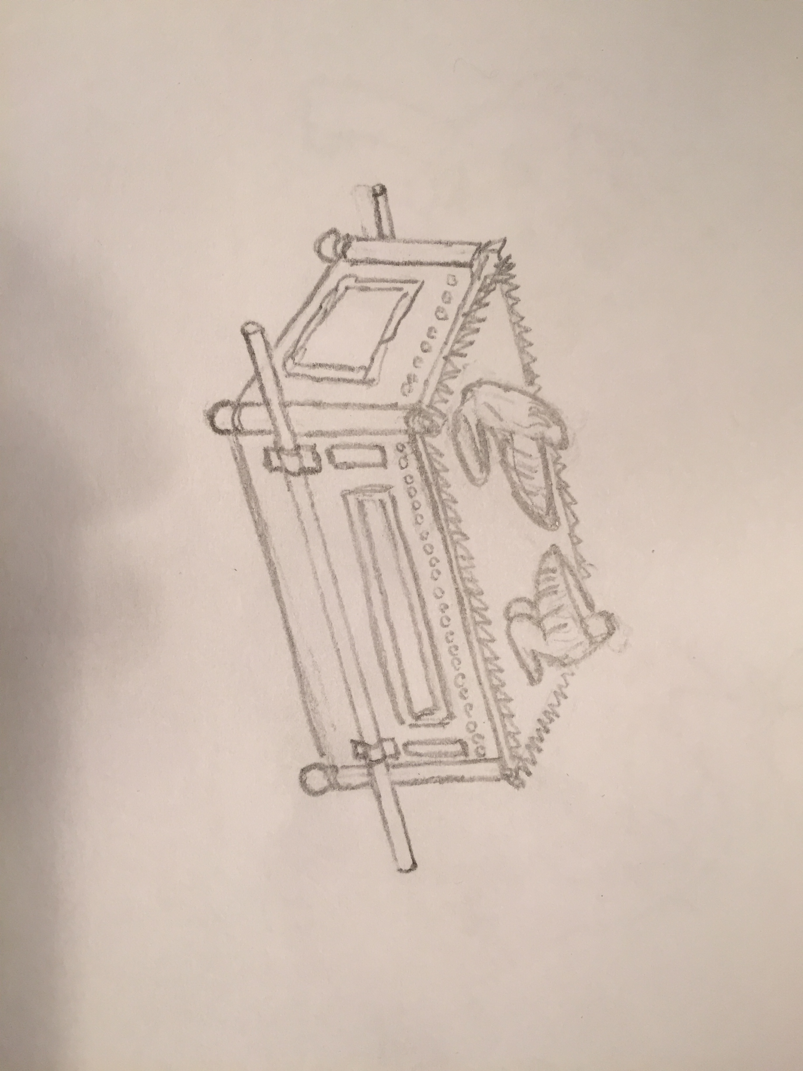
Notes:
The fight continues on within the tomb. The goblins continue to fall to your strength.
A small goblin, hiding in the back, pulls from its garments a flask that glows. The reddish light fills the chamber. The cloudy contents swirl and churn about within the container. This goblin opens the flask and in a single motion pours it down into it's mouth. The excess liquid that the goblin cannot swallow pours over and down its body spilling onto the ground below.
The goblin falls falls forward onto its hands. It remains stationary for a brief moment before the body of the goblin grows in size taking on elements of a serpent. Scales and widened eyes. It's legs replaced with serpent like limbs.
It bends itself upwards and then charges towards you.

Slide 42
Unraveling the Power of the Ark
Introduction
The Encounter
Concepts
Exercise
Review

Slide 43
Changing into the Cookbook Directory
> cd ~/ark

Slide 44
Executing the Test Suite
> chef exec rspec spec/unit/recipes/default_spec.rb
...................
Finished in 3.58 seconds (files took 2.73 seconds to load)
19 examples, 0 failures
ChefSpec Coverage report generated...
Total Resources: 41
Touched Resources: 41
Touch Coverage: 100.0%

Slide 45
Viewing the Recipe Specification
~/ark/spec/unit/recipes/default_spec.rb
require 'spec_helper'
describe 'ark::default' do
let(:chef_run) do
runner = ChefSpec::SoloRunner.new(node_attributes)
runner.converge(described_recipe)
end
let(:node_attributes) do
{}
end

Slide 46
Reusing More of the Test Suite*
The solutions you found (or started to find) would likely be useable by other tests with the same cookbook and possibly another cookbook.
There are a few more spells and abilities one could apply to help combat the redundancy in this test file.
Adventurers, your goal is to further reduce the size and complexity of this test file.
Notes:
* Reusing more source code is the dream of software development. Sometimes it is possible. Sometimes it is not. But what I do know is that the better the code is factored the more easy it is to make that dream come true when it comes time.

Slide 47
Unraveling the Power of the Ark
Introduction
The Encounter
Concepts
Exercise
Review

Slide 48
Prismatic require
Loads the given name, returning true if successful and false if the feature is already loaded.
If the filename does not resolve to an absolute path, it will be searched for in the directories listed in $LOAD_PATH ($:).
http://goo.gl/cLKY37

Slide 49
Requiring the spec_helper file
~/ark/spec/unit/recipes/default_spec.rb
require 'spec_helper'
describe 'ark::default' do
context 'when no attributes are specified, on an ...platform' do
let(:chef_run) do
runner = ChefSpec::SoloRunner.new
runner.converge(described_recipe)
end

Slide 50
Viewing the spec_helper file
~/ark/spec/spec_helper.rb
require 'chefspec'
require 'chefspec/berkshelf'
at_exit { ChefSpec::Coverage.report! }
RSpec.configure do |config|
config.color = true
end
# puts $LOAD_PATH
# ... define test helpers and content in this file

Slide 51
Viewing the $LOAD_PATH
> chef exec rspec
/opt/chefdk/embedded/lib/ruby/gems/2.1.0/gems/uuidtools-2.1.5/lib
/Users/franklinwebber/ark/spec
/Users/franklinwebber/.chefdk/gem/ruby/2.1.0/gems/rspec-support-3.4.1/lib
/Users/franklinwebber/.chefdk/gem/ruby/2.1.0/gems/rspec-core-3.4.4/lib
/opt/chefdk/embedded/lib/ruby/gems/2.1.0/gems/net-ssh-3.1.1/lib
/opt/chefdk/embedded/lib/ruby/gems/2.1.0/gems/fauxhai-3.5.0/lib
/opt/chefdk/embedded/lib/ruby/gems/2.1.0/gems/diff-lcs-1.2.5/lib
/Users/franklinwebber/.chefdk/gem/ruby/2.1.0/gems/rspec-expectations-3.4.0/lib
/Users/franklinwebber/.chefdk/gem/ruby/2.1.0/gems/rspec-mocks-3.4.1/lib
/Users/franklinwebber/.chefdk/gem/ruby/2.1.0/gems/rspec-3.4.0/lib

Slide 52
Greater require_relative
Ruby tries to load the library named string relative to the requiring file's path. If the file's path cannot be determined a LoadError is raised. If a file is loaded true is returned and false otherwise.
http://goo.gl/Gv8QdI

Slide 53
Create helper method
You can define a Ruby method that takes care of some of the tedious work of retrieving node attributes.

Slide 54
Viewing the Repetition of Retrieving Attributes
it "apache mirror" do
attribute = chef_run.node['ark']['apache_mirror']
expect(attribute).to eq "http://apache.mirrors.tds.net"
end
it "prefix root" do
attribute = chef_run.node['ark']['prefix_root']
expect(attribute).to eq "/usr/local"
end

Slide 55
Refactoring with let to help ease the pain
let(:node) do
chef_run.node
end
it "apache mirror" do
attribute = node['ark']['apache_mirror']
expect(attribute).to eq "http://apache.mirrors.tds.net"
end
it "prefix root" do
attribute = node['ark']['prefix_root']
expect(attribute).to eq "/usr/local"
end

Slide 56
Implementing a Helper Method
let(:node) do
chef_run.node
end
def attribute(name)
node[described_cookbook][name]
end
it "apache mirror" do
expect(attribute('apache_mirror')).to eq "http://apache.mirr....net"
end
it "prefix root" do
expect(attribute('prefix_root')).to eq "/usr/local"
end

Slide 57
Ray of shared_context
Use shared_context to define a block that will be evaluated in the context of example groups either explicitly, using include_context, or implicitly by matching metdata.
http://goo.gl/R0ujTA

Slide 58
Repeating More than Examples
describe 'ark::default' do
context 'when no attributes are specified, on an uns...platform' do
let(:chef_run) do
runner = ChefSpec::SoloRunner.new(node_attributes)
runner.converge(described_recipe)
end
let(:node_attributes) do
{}
end
def attribute(name) ...

Slide 59
Repeating More than Examples
shared_context 'converged recipe' do
let(:chef_run) do
runner = ChefSpec::SoloRunner.new(node_attributes)
runner.converge(described_recipe)
end
let(:node_attributes) do
{}
end
def attribute(name) ...
end
describe 'ark::default' do
context 'when no attributes are specified, on an uns...platform' do
include_context 'converged recipe'

Slide 60
alias_example_group_to
describe and context are the default aliases for example_group. You can define your own aliases for example_group and give those custom aliases default metadata.
http://goo.gl/DfUChL

Slide 61
Viewing a Spec with include_context
~/ark/spec/unit/recipes/default_spec.rb
describe 'ark::default' do
context 'when no attributes are specified, on an ...platform' do
include_context 'converged recipe'
# ... examples ...
end
# ... other contexts ...
end

Slide 62
Refactoring the Spec to auto include the context
describe_recipe 'ark::default' do
context 'when no attributes are specified, on an uns...platform' do
include_context 'converged recipe'
# ... examples ...
end
# ... other contexts
end

Slide 63
Defining the alias and tying it to the shared_context
~/ark/spec/spec_helper.rb
require 'chefspec'
require 'chefspec/berkshelf'
at_exit { ChefSpec::Coverage.report! }
RSpec.configure do |config|
config.color = true
config.alias_example_group_to :describe_recipe, :type => :recipe
end
shared_context 'converged recipe', :type => :recipe do

Slide 64
Unraveling the Power of the Ark
Introduction
The Encounter
Concepts
Exercise
Review

Slide 65
Exercise
Continue to refactor the the Ark's default recipe specification using:
Power Word: let
Conjure shared_examples
Greater helper method
Ray of shared_context
alias_example_group_to
Success
All tests pass and the size of the recipe specification has been decreased.

Slide 66
Unraveling the Power of the Ark
Introduction
The Encounter
Concepts
Exercise
Review

Slide 67
Change in to the Cookbook Directory
> cd ~/ark

Slide 68
Execute the Test Suite
> chef exec rspec spec/unit/recipes/default_spec.rb
...................
Finished in 3.58 seconds (files took 2.73 seconds to load)
19 examples, 0 failures
ChefSpec Coverage report generated...
Total Resources: 41
Touched Resources: 41
Touch Coverage: 100.0%

Slide 69
Edit the Recipe Specification File
~/ark/spec/unit/recipes/default_spec.rb
require 'spec_helper'
describe 'ark::default' do
context 'when no attributes are specified, on a...d platform' do
let(:chef_run) do
runner = ChefSpec::SoloRunner.new
runner.converge(described_recipe)
end
it 'installs necessary packages' do

Slide 70
Live Demonstration
https://goo.gl/ESxebk
https://goo.gl/9mRNlD
(lowercase L)
one = 1

Slide 71
Unraveling the Power of the Ark
Introduction
The Encounter
Concepts
Exercise
Review

Slide 73

The Ark's Power Realized
Introduction
The Encounter
Concepts
Exercise
Review
Notes:
Nullfy from Nullfy.com! @ https://flic.kr/p/qC7Qhn

Slide 74
Notes:
Recovering the Ark from the Goblins and the malformed protector was no small feat. The larger task lay ahead which is understanding how to use it. By examining the runes along the side of it and with the aid of spiritual tomes granted to you it feels like you could wield the power that it possesses.
Your goal now is to understand how to use this powerful tool so that you can bring an end to this corruption that is taking your land.

Slide 75
The Ark's Power Realized
Introduction
The Encounter
Concepts
Exercise
Review
Notes:
Nullfy from Nullfy.com! @ https://flic.kr/p/qC7Qhn

Slide 76
How is the Ark Used?
The default recipe describes the components necessary for Ark to work but not how it is used.
To learn how to use the Ark one must employ it. But instead of simply unleashing it we should write a test to ensure it can do what we want it to do ... which is build an application from source.
Adventurers your goal is to write a test that demonstrates the install_with_make action of Ark.

Slide 77
Viewing the Features of the Ark
~/ark/resources/default.rb
actions :install, :dump, :cherry_pick, :put, :install_with_make, :configure, :setup_py_build, :setup_py_install, :setup_py, :unzip
default_action :install
attr_accessor :path, :release_file, :prefix_bin, :prefix_root, :home_dir, :extension, :version
attribute :owner, :kind_of => String, :default => 'root'
attribute :group, :kind_of => [String, Fixnum], :default => 0
attribute :url, :kind_of => String, :required => true
attribute :path, :kind_of => String, :default => nil
attribute :full_path, :kind_of => String, :default => nil

Slide 78
Understanding the Path of an Action
action :install_with_make do
directory new_resource.path
remote_file new_resource.release_file do
notifies :run, "execute[unpack #{new_resource.release_file}]"
end
1
2
1
Creates a directory to do work (directory)
Retrieves an application source (remote_file)
2

Slide 79
Understanding the Path of an Action
3
execute "unpack #{new_resource.release_file}" do
notifies :run, "execute[set owner on #{new_resource.path}]"
notifies :run, "execute[autogen #{new_resource.path}]"
notifies :run, "execute[configure #{new_resource.path}]"
notifies :run, "execute[make #{new_resource.path}]"
notifies :run, "execute[make install #{new_resource.path}]"
action :nothing
end
3
Extracts the source (execute)

Slide 80
Understanding the Path of an Action
execute "set owner on #{new_resource.path}"
execute "autogen #{new_resource.path}"
execute "configure #{new_resource.path}"
execute "make #{new_resource.path}"
execute "make install #{new_resource.path}"
end
4
5
6
7
8
Sets the owner of the source (execute)
Autogen the source - if needed (execute)
Configures the source (execute)
Makes the source (execute)
Installs the source (execute)
4
5
6
7
8

Slide 81
How is the Ark Used?
The default recipe describes the components necessary for Ark to work but not how it is used.
To learn how to use the Ark one must employ it. But instead of simply unleashing it we should write a test to ensure it can do what we want it to do ... which is build an application from source.
Adventurers your goal is to write a test that demonstrates the install_with_make action of Ark.

Slide 82
The Ark's Power Realized
Introduction
The Encounter
Concepts
Exercise
Review
Notes:
Nullfy from Nullfy.com! @ https://flic.kr/p/qC7Qhn

Slide 83
Fixture Cookbook
Defining a cookbook, within a cookbook's test directory, that employs the cookbook in the various ways in which it may be used by downstream cookbooks.
This is often to ensure test coverage for features not in the defined recipes and their associated tests. Common if you are building a cookbook that employs a custom resource.

Slide 84
Creating the Fixture Cookbook
> cd ~/ark
> mkdir spec/fixtures
> chef generate cookbook spec/fixtures/ark_spec

Slide 85
Updating the Dependencies to Fixture Cookbook
~/ark/Berksfile
source "http://api.berkshelf.com"
metadata
cookbook 'ark_spec', path: 'spec/fixtures/ark_spec'

Slide 86
Defining Test Recipes
Within the fixture cookbook you now would define recipes that employ the custom resource is the most essential ways.

Slide 87
Viewing All the Defined Recipes
> ls spec/fixtures/ark_spec/recipes
spec/fixtures/ark_spec/recipes
├── cherry_pick.rb
├── cherry_pick_with_zip.rb
├── configure.rb
├── dump.rb
├── install.rb
├── install_no_stripping.rb
├── install_stripping.rb
├── install_windows.rb
├── install_with_append_env_path.rb

Slide 88
Viewing the install Recipe
~/ark/spec/fixtures/ark_spec/recipes/install.rb
ark 'test_install' do
url 'https://github.com/burtlo/ark/raw/master/fil.../foo.tar.gz'
checksum '5996e676f17457c823d86...81e70d6a0e5f8e45b51e62e0c52e8'
version '2'
prefix_root '/usr/local'
owner 'foobarbaz'
group 'foobarbaz'
action :install
end

Slide 89
Defining the Test for Each Recipe
For every recipe you write you now need to define a test for them.

Slide 90
Viewing the Tests for each Fixture Recipe
~/ark/spec/unit/resources/default_spec.rb
require 'spec_helper'
describe 'ark' do
# ... helpers and setup ...
describe 'install' do
let(:described_recipe) { 'ark_spec::install' }
it 'generates the expected ... actions and notifications' do
expect(chef_run).to install_ark('test_install')

Slide 91
Defining ChefSpec Matchers
ChefSpec exposes the ability for cookbook authors to package custom matchers inside a cookbook so that other developers may take advantage of them in testing.
https://goo.gl/lSQDXD

Slide 92
Defining a ChefSpec Resource Matcher
~/ark/libraries/matchers.rb
if defined?(ChefSpec)
def install_ark(resource_name)
ChefSpec::Matchers::ResourceMatcher.new(:ark, :install, resource_name)
end
# TODO: Define additional matchers for each supported action ...
#
# actions :install, :install_with_make, :dump, :cherry_pick, :put
# :configure, :setup_py_build, :setup_py_install, :setup_py, :unzip
end

Slide 93
ChefSpec's step_into
ChefSpec overrides all providers to take no action (otherwise it would actually converge your system). This means that the steps inside your custom resource are not actually executed. If a custom resource performs actions, those actions are never executed or added to the resource collection.
In order to run the actions exposed by your custom resource, you have to explicitly tell the Runner to step into it.
https://goo.gl/SKM4L3

Slide 94
Stepping to the Custom Resource
~/ark/spec/unit/resources/default_spec.rb
require 'spec_helper'
describe 'ark' do
let(:chef_run) do
runner = ChefSpec::SoloRunner.new(node_attributes.merge(settings).merge(step_into))
runner.converge(described_recipe)
runner
end
# This is required to test the internal components of a LWRP / Custom Resource
# @see https://github.com/sethvargo/chefspec#testing-lwrps
let(:step_into) do
{ step_into: ['ark'] }
end

Slide 95
Stepping Into Gives You Visibility Into the Resource
R₀
ark
ChefSpec::SoloRunner.new(step_into: 'ark')
R₁
R₂
R₃
R₄
R₅
R₆
R₇
R₈

Slide 96
Stepping into Allows Testing of Resources
~/ark/spec/unit/resources/default_spec.rb
describe 'install' do
let(:described_recipe) { 'ark_spec::install' }
it 'generates the expected resources with the expected acti... notifications' do
expect(chef_run).to install_ark('test_install')
expect(chef_run).to create_directory('/usr/local/test_install-2')
resource = chef_run.directory('/usr/local/test_install-2')
expect(resource).to notify('execute[unpack /var/chef/cache/test_install-2.t...
expect(chef_run).to create_remote_file('/var/chef/cache/test_install-2.tar....
resource = chef_run.remote_file('/var/chef/cache/test_install-2.tar.gz')
expect(resource).to notify('execute[unpack /var/chef/cache/test_install-2.t...
# ... testing other resources within the custom resource action ...
1
2

Slide 97
The Ark's Power Realized
Introduction
The Encounter
Concepts
Exercise
Review
Notes:
Nullfy from Nullfy.com! @ https://flic.kr/p/qC7Qhn

Slide 98
Exercise
Define an `install_with_make_ark` ChefSpec Resource Matcher
Edit `~/ark/spec/unit/resources/default_spec.rb` and define the 'install_with_make' example
Run `chef exec rspec spec/unit/resources/default_spec.rb`
Success
The 'install_with_make' example passes with 100% coverage

Slide 99
The Ark's Power Realized
Introduction
The Encounter
Concepts
Exercise
Review
Notes:
Nullfy from Nullfy.com! @ https://flic.kr/p/qC7Qhn

Slide 100
Change in to the Cookbook Directory
> cd ~/ark

Slide 101
Execute the Test Suite
> chef exec rspec spec/unit/resources/default_spec.rb:57

Slide 102
Edit the Resource Specification File
~/ark/spec/unit/resources/default_spec.rb
require 'spec_helper'
describe 'ark' do
let(:chef_run) do
runner = ChefSpec::SoloRunner.new(node_attributes.merge(set...
runner.converge(described_recipe)
runner
end
let(:node_attributes) do
{}
end

Slide 103
Live Demonstration
https://goo.gl/DIjNcZ

Slide 104
The Ark's Power Realized
Introduction
The Encounter
Concepts
Exercise
Review
Notes:
Nullfy from Nullfy.com! @ https://flic.kr/p/qC7Qhn

Slide 106
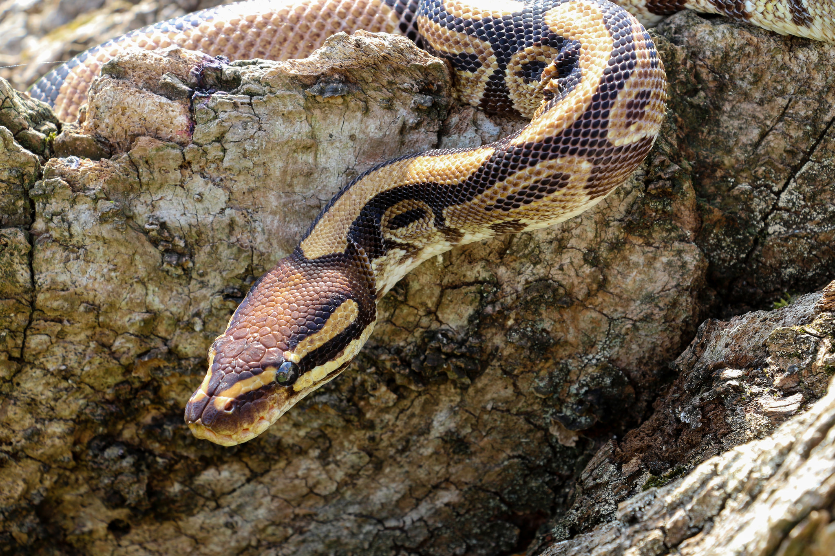
The Python's Scales
Introduction
The Encounter
Concepts
Exercise
Review
Notes:
Chris Parker @ https://flic.kr/p/oLXRTD

Slide 107
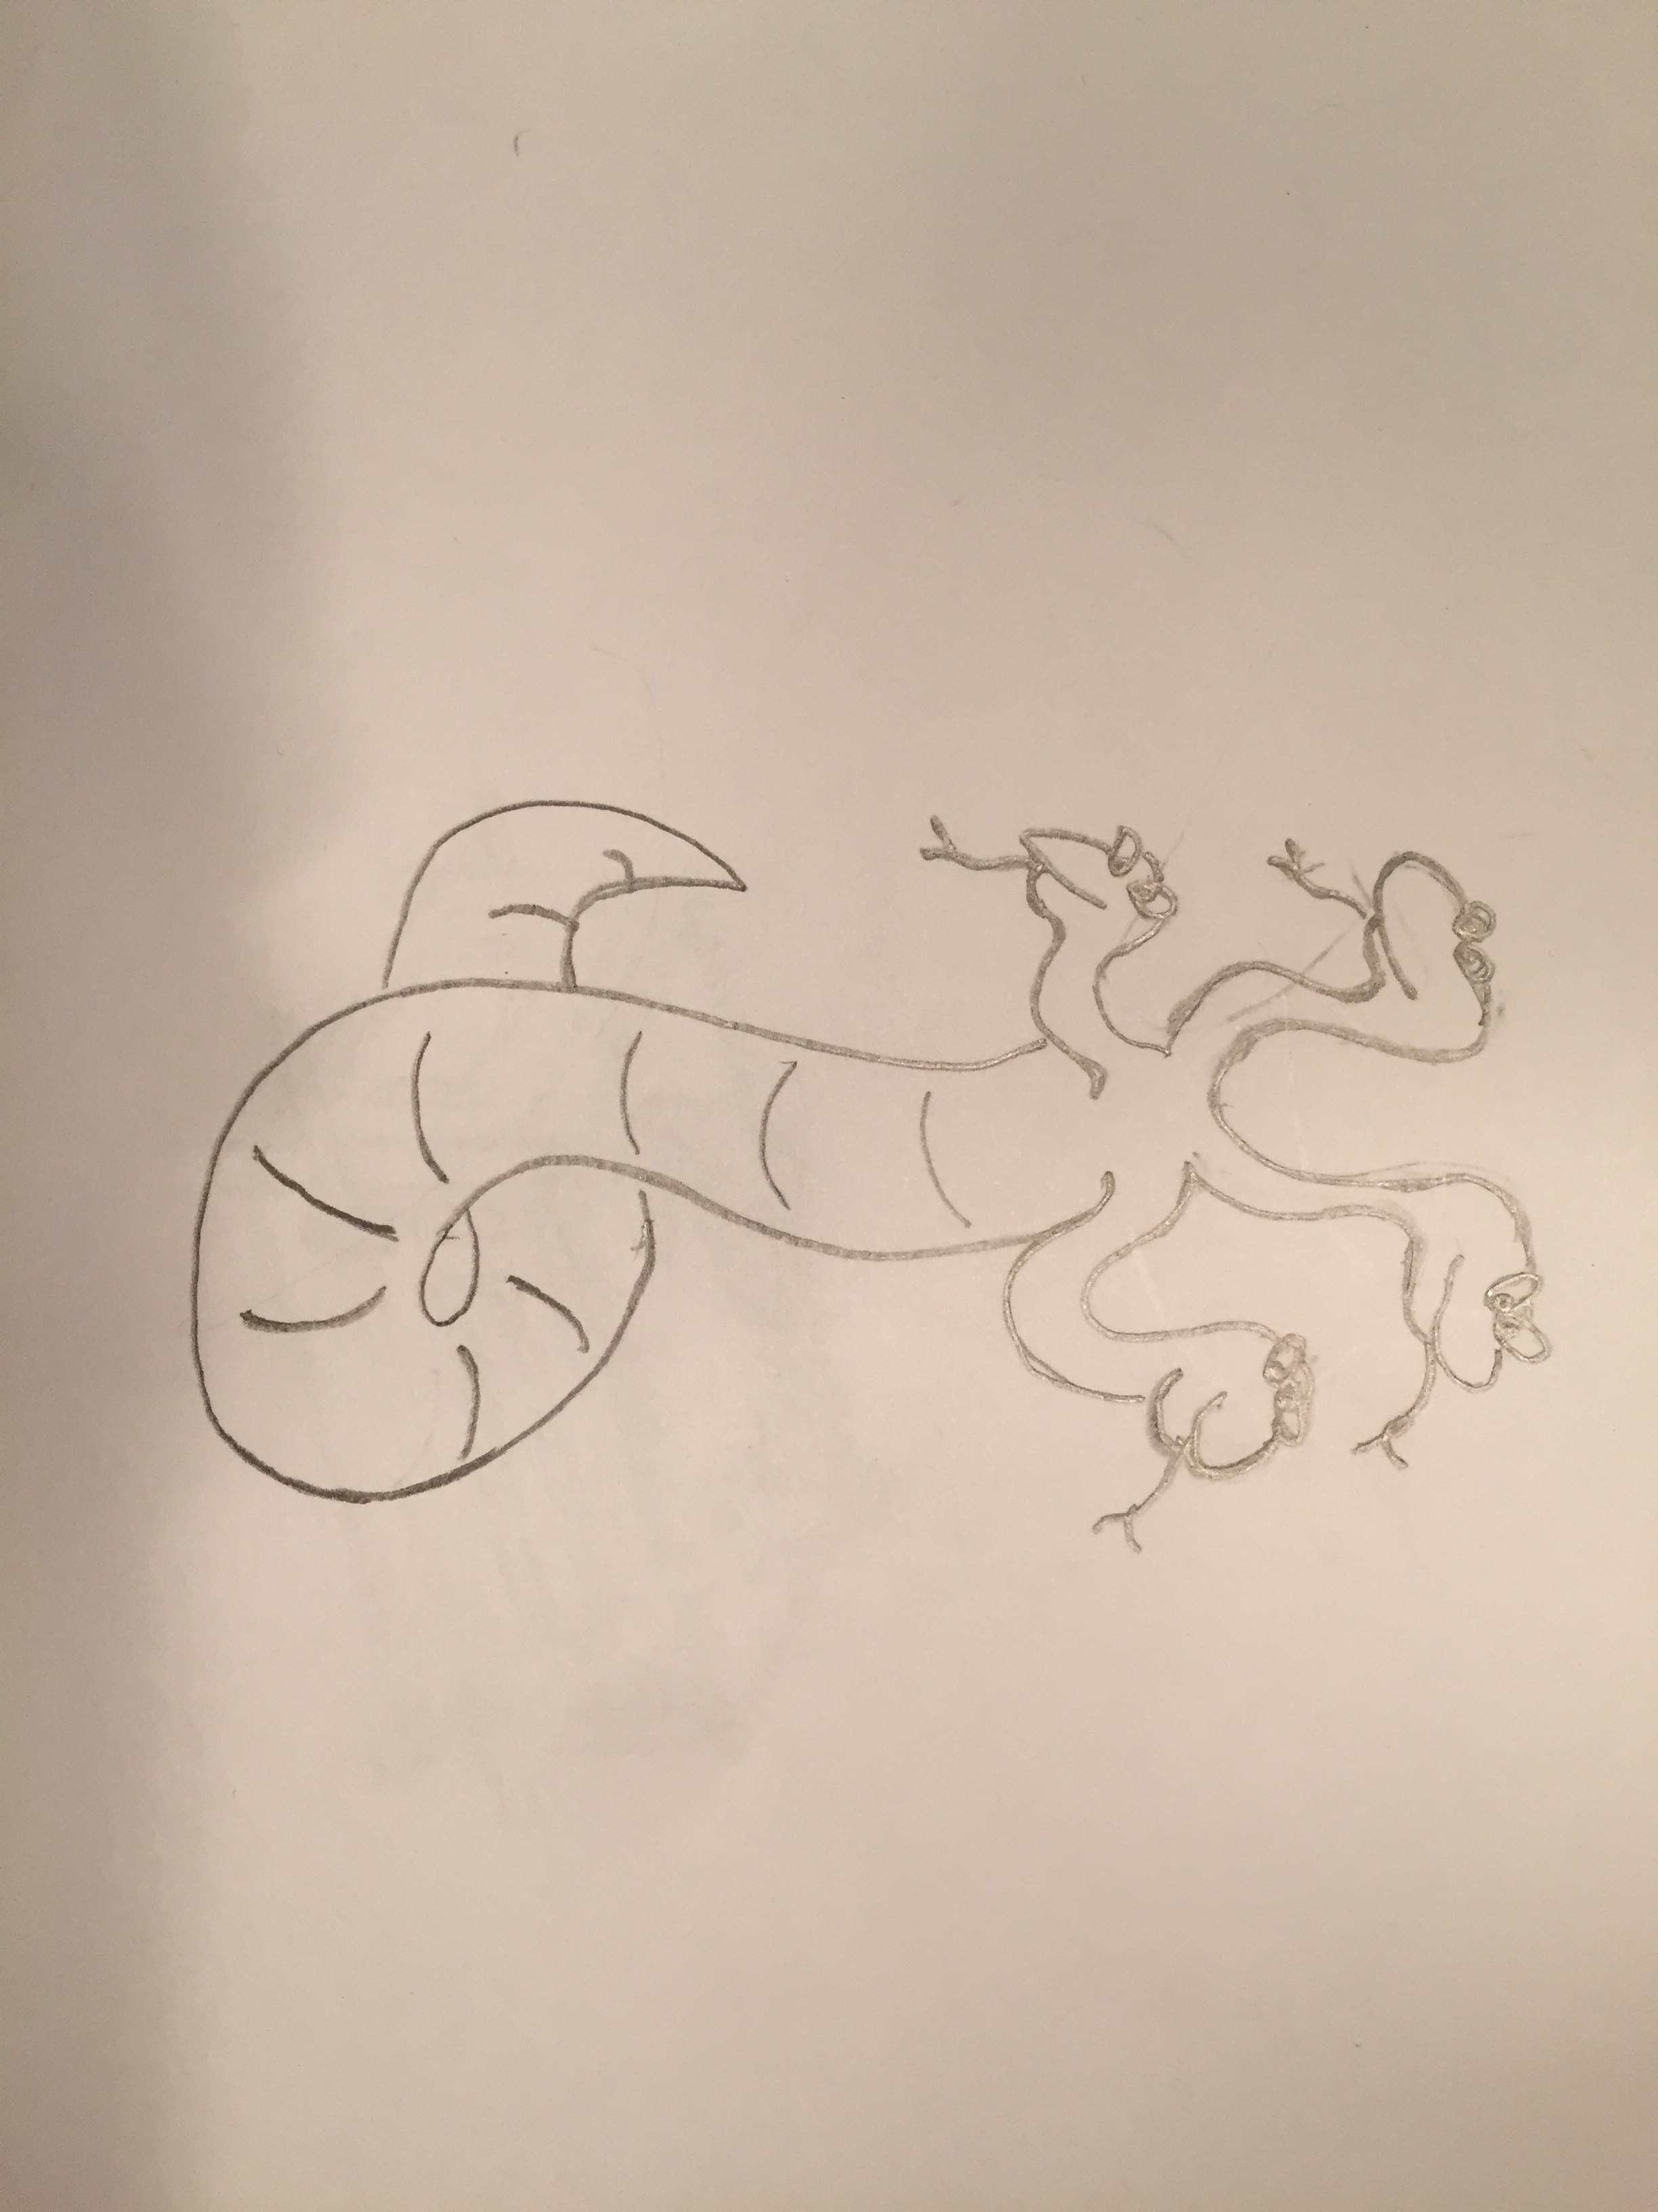
Notes:
The python's chamber is riddled with the weapons and the implements of those that have fallen facing it. The ground covered in the molted skin of the beast. Carrying the Ark into this chamber is difficult footing.
The darkness here is oppressing, dampening your sight, light spells, and torches. A fear begins to take hold within you - doubts. Will you be able to remember how to use the Ark to defeat the Python.
Your footfalls fail to echo and it feels as though you are in a smaller chamber than the one in which you now stand. From the hall the head of the Python appears. It hisses and slowly moves towards you. Your eyes focus on it as it slithers towards you. As you raise your weapons and prepare your spells you begin to feel your distance from one another growing farther apart (though you are standing still). You feel the walls closing in around.
It is then you realize that the whole of the python is all around and below you. You must win this fight or find yourself crushed to death.

Slide 108
The Python's Scales
Introduction
The Encounter
Concepts
Exercise
Review
Notes:
Chris Parker @ https://flic.kr/p/oLXRTD

Slide 109
Viewing the Python's Default Recipe
~/python/recipes/default.rb
remote_file '/tmp/Python-3.4.4.tgz' do
source 'https://www.python.org/ftp/python/3.4.4/Python-3.4.4.tgz'
notifies :run, 'execute[extract python]', :immediately
end
execute 'extract python' do
command 'tar xzf /tmp/Python-3.4.4.tgz'
cwd '/tmp'
action :nothing
notifies :run, 'execute[python build and install]', :immediately
end
# ... CONTINUES ON THE NEXT SLIDE ...

Slide 110
Viewing the Python's Default Recipe
~/python/recipes/default.rb
# ... CONTINUED FROM THE PREVIOUS SLIDE ...
execute 'extract python' do
command 'tar xzf /tmp/Python-3.4.4.tgz'
cwd '/tmp'
action :nothing
notifies :run, 'execute[python build and install]', :immediately
end
execute 'python build and install' do
command './configure && make install'
cwd '/tmp/Python-3.4.4'
action :nothing
end

Slide 111
Python's default Recipe
Ark's install_with_make
Retrieve the Python source (remote_file)
Extracts the source (execute)
Configures the source (execute)
Installs the source (execute)
Creates a directory to do work (directory)
Retrieves an application source (remote_file)
Extracts the source (execute)
Sets the owner of the source (execute)
Autogen the source - if needed (execute)
Configures the source (execute)
Makes the source (execute)
Installs the source (execute)

Slide 112
Using the Ark to Slay the Python
Replacing these three resources with a single resource will make the recipe much more readable and possibly more maintainable.
Adventurers your FIRST goal is to replace the existing installation method with the Ark resource.

Slide 113
Using the Python's Pip as a Weapon
When Python is installed it also installs a tool called pip that allows you to install packages. Cookbooks that rely on the python cookbook will likely need Python installed and need access to this tool.
Adventurers your Second goal is to create a custom resource that allows you to leverage the pip tool in other cookbooks.

Slide 114
The Python's Scales
Introduction
The Encounter
Concepts
Exercise
Review
Notes:
Chris Parker @ https://flic.kr/p/oLXRTD

Slide 115
Custom Resource
A custom resource is a simple extension of Chef that is implemented as part of a cookbook. It follows easy, repeatable syntax patterns and effectively leverages resources that are built into Chef.
The result is reusable in the same way as resources that are built into Chef.
https://docs.chef.io/custom_resources.html

Slide 116
~/python/spec/fixtures/python_spec/recipes/pip_install.rb
pip 'django'

Slide 117
~/python/spec/fixtures/python_spec/recipes/pip_install.rb
pip 'django' do
action :install
end

Slide 118
~/python/spec/fixtures/python_spec/recipes/pip_install.rb
pip 'django' do
package_name 'django'
action :install
end

Slide 119
Changing into the Directory of the Cookbook
> cd ~/python

Slide 120
Generating an LWRP in the Cookbook
> chef generate lwrp pip

Slide 121
Removing the Unnecessary Providers Directory
> rm -rf providers

Slide 122
Defining the name of the resource
~/python/resources/pip.rb
resource_name :pip

Slide 123
Custom Resource: action
Each custom resource must have at least one action that is defined within an action block.
The first action defined in the resource definition is considered the default action.
https://docs.chef.io/custom_resources.html#define-actions

Slide 124
Defining an Action
~/python/resources/pip.rb
resource_name :pip
action :install do
# ... contains the resources needed to converge
end

Slide 125
Defining an Action
~/python/resources/pip.rb
resource_name :pip
action :install do
execute '/usr/local/bin/pip3 install PACKAGENAME'
end

Slide 126
Custom Resource: property
Custom properties are defined in the resource. A property describes a field that a user of the custom resource can set when they define the custom resource within their recipes.
These properties have a type, can have default values, or be set to retrieve the value from the name of the resource.
https://docs.chef.io/custom_resources.html#define-properties

Slide 127
Defining an Action
~/python/resources/pip.rb
resource_name :pip
property :package_name, String
action :install do
execute "/usr/local/bin/pip3 install #{package_name}"
end

Slide 128
Custom Resource: name_property
Custom properties are defined in the resource. A property describes a field that a user of the custom resource can set when they define the custom resource within their recipes.
These properties have a type, can have default values, or be set to retrieve the value from the name of the resource.
https://docs.chef.io/custom_resources.html#define-properties

Slide 129
Defining an Action
~/python/resources/pip.rb
resource_name :pip
property :package_name, String, name_property: true
action :install do
execute "/usr/local/bin/pip3 install #{package_name}"
end

Slide 130
The Python's Scales
Introduction
The Encounter
Concepts
Exercise
Review
Notes:
Chris Parker @ https://flic.kr/p/oLXRTD

Slide 131
Exercise
Refactor the Python cookbook's default recipe to use the ark resource to install_with_make Python 3.4.4
Define a custom resource, named `pip`
Success
All tests pass for the Python cookbook with 100% coverage

Slide 132
The Python's Scales
Introduction
The Encounter
Concepts
Exercise
Review
Notes:
Chris Parker @ https://flic.kr/p/oLXRTD

Slide 133
Live Demonstration
https://goo.gl/Etc9Gv

Slide 134
The Python's Scales
Introduction
The Encounter
Concepts
Exercise
Review
Notes:
Chris Parker @ https://flic.kr/p/oLXRTD

Slide 136
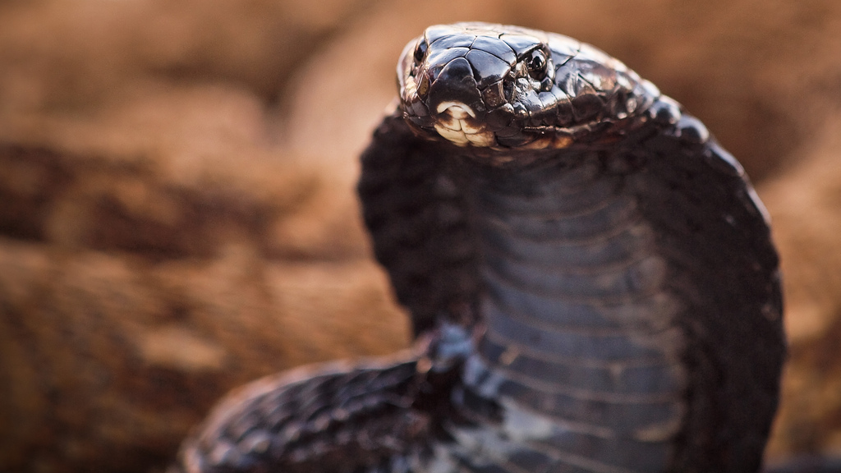
Challenging the Golden Cobra
Introduction
The Encounter
Concepts
Exercise
Review
Notes:
Luca Boldrini @ https://flic.kr/p/7wo8dk

Slide 137
Notes:
The stories of the throne room of the golden cobra are lackluster and dull compared to the stories you were told as a child. The dull, musty odor of years of rest fills the chamber. Upon the throne the Golden Cobra rests. It's body wrapped around the base and it's upper portion resting gently.
When you enter it barely moves - you believe it a statue or a carving. But surely and slowly over time it's head raises and it's neck flattens. It moves fluidly and dances upward as it's eyes fixates on you. You feel lost in a dream for a moment, unable to turn away.
The cobra strikes a body laying upon the ground. It's head slowly retracts and from the exposed fangs you see the same red toxin you witnessed the goblin taking in the other chamber. It quickly strikes again at another body on the ground.
Within seconds the bodies rise and these tainted creatures start to move toward you.

Slide 138
Challenging the Golden Cobra
Introduction
The Encounter
Concepts
Exercise
Review
Notes:
Luca Boldrini @ https://flic.kr/p/7wo8dk

Slide 139
The Golden Cobra Has Requirements
The golden_cobra cookbook is an application cookbook that deploys a Django application. It needs Python installed, a number of Python packages, and relies on a data bag.
Adventurers your goal is to finish the golden_cobra!

Slide 140
Viewing the Existing Default Recipe
~/golden_cobra/recipes/default.rb
execute 'yum update -y'
package 'sqlite-devel'
# TODO: install python 3.4.4
# TODO: install python packages: django, uwsgi, and gunicorn
directory '/sites'
package 'git'
# ... CONTINUES ON THE NEXT SLIDE ...

Slide 141
Viewing the Existing Default Recipe
~/golden_cobra/recipes/default.rb
# ... CONTINUED FROM THE PREVIOUS SLIDE ...
search('site','*:*').each do |site_data|
git "/sites/#{site_name}" # ... collapsed definitions
execute '/usr/local/bin/python3 manage.py migrate' #...
execute "gunicorn #{site_name}.wsgi -D -b #{site_bind}" #...
end

Slide 142
The Golden Cobra Has Requirements
The golden_cobra cookbook is an application cookbook that deploys a Django application. It needs Python installed, a number of Python packages, and relies on a data bag.
Adventurers your goal is to finish the golden_cobra!

Slide 143
Challenging the Golden Cobra
Introduction
The Encounter
Concepts
Exercise
Review
Notes:
Luca Boldrini @ https://flic.kr/p/7wo8dk

Slide 144
Stubbing Search
Because ChefSpec is a unit-testing framework, it is recommended that all third-party API calls be mocked or stubbed. ChefSpec exposes a helpful RSpec macro for stubbing search results in your tests.
If you converge a Chef recipe that implements a search call ChefSpec will throw an error. You may stub the search call to prevent the error and test a variety of search results that could be returned.
https://github.com/sethvargo/chefspec#search

Slide 145
ServerRunner vs SoloRunner
There are two runners available when defining your specifications. Choosing the right one is often dependent on the context of how this cookbook/recipe will be used within your organization.
Stubbing Search and other values is different based on the runner that you choose.

Slide 146
Viewing a Standard ServerRunner Definition
let(:chef_run) do
runner = ChefSpec::ServerRunner.new
runner.converge(described_recipe)
end

Slide 147
Expanding the ServerRunner Definition
let(:chef_run) do
runner = ChefSpec::ServerRunner.new do |node,server|
# setup additional details about the state of the node
# setup additional details about the state of the server
end
runner.converge(described_recipe)
end

Slide 148
Creating a Data Bag on the Server
let(:chef_run) do
runner = ChefSpec::ServerRunner.new do |node,server|
server.create_data_bag('users', {
'fwebber' => {
'name' => 'fwebber',
'home' => '/home/fwebber'
}
})
end
runner.converge(described_recipe)
end

Slide 149
Challenging the Golden Cobra
Introduction
The Encounter
Concepts
Exercise
Review
Notes:
Luca Boldrini @ https://flic.kr/p/7wo8dk

Slide 150
Exercise
Execute the golden_cobra cookbook's tests and identify the failures
Update the test suite to stub the search results
Update the recipe to include needed recipes and resources
Success
All tests pass with 100% coverage

Slide 151
Challenging the Golden Cobra
Introduction
The Encounter
Concepts
Exercise
Review
Notes:
Luca Boldrini @ https://flic.kr/p/7wo8dk

Slide 152
Live Demonstration
https://goo.gl/2vMP9k

Slide 153
Challenging the Golden Cobra
Introduction
The Encounter
Concepts
Exercise
Review
Notes:
Luca Boldrini @ https://flic.kr/p/7wo8dk

Slide 155

Securing the Power of the Ark
Introduction
The Encounter
Concepts
Exercise
Review
Notes:
Andrea Kirby @ https://flic.kr/p/9h1bLJ

Slide 156
Notes:
The ark has been recovered and with it you were able to undo the damage that it has wrought. But the power of it remains to vast and unknowable for you at the moment and for anyone else for that matter. To easy for its use to go wrong.
To help bring an end to its power you must bind it forever by performing the ritual that your elders have granted you.

Slide 157
Notes:
Recovering the Ark from the Goblins and the malformed protector was no small feat. The larger task lay ahead which is understanding how to use it. By examining the runes along the side of it and with the aid of spiritual tomes granted to you it feels like you could wield the power that it possesses.
Your goal now is to understand how to use this powerful tool so that you can bring an end to this corruption that is taking your land.

Slide 158
Securing the Power of the Ark
Introduction
The Encounter
Concepts
Exercise
Review
Notes:
Andrea Kirby @ https://flic.kr/p/9h1bLJ

Slide 159
Testing Everything Through Recipes
The recipes in the fixture cookbook do a good job testing the custom resource from end-to-end but to to test all of the code paths one would need to generate a lot more recipes. This is because the Ark cookbook relies on some complex helper methods
Instead of testing each path through the code at the recipe level we can isolate the helper and test it with a large set of inputs. Testing them in isolation will allow better coverage at the boundaries and delivers results faster.
Adventurers your goal is to test a single helper method!

Slide 160
Securing the Power of the Ark
Introduction
The Encounter
Concepts
Exercise
Review
Notes:
Andrea Kirby @ https://flic.kr/p/9h1bLJ

Slide 161
Helper Methods
To create more concise recipes code is often defined in methods that are stored in modules. These modules are then included within the recipe or the resources when the cookbook is loaded.
These helper methods provide an easy way to simplify, on the surface, complicated logic that may need to be calculated or retrieved from the system.

Slide 162
Include in a Class
Methods defined within a module is portable code that can be inserted into any context that includes them. This is often done at the start of the recipe which includes the methods into the Chef::Recipe class.
This same tactic can be used within any class that you may choose to define.

Slide 163
A module Defines Methods
module Challenges
def monsters ; end
def traps ; end
def mystery ; end
def treasure ; end
end

Slide 164
Including a Module Grants the Object those Methods
module Challenges
def monsters ; end
def traps ; end
def mystery ; end
def treasure ; end
end
class Dungeon
include Challenges
end
dungeon = Dungeon.new
dungeon.monsters

Slide 165
Including a Module Grants the Object those Methods
module Challenges
def monsters ; end
def traps ; end
def mystery ; end
def treasure ; end
end
class Castle
include Challenges
end
castle = Castle.new
castle.monsters

Slide 166
Viewing One Helper Method
module Opscode
module Ark
module ProviderHelpers
def cherry_pick_tar_command(tar_args)
cmd = node['ark']['tar']
cmd += " #{tar_args}"
cmd += " #{new_resource.release_file}"
cmd += " -C"
cmd += " #{new_resource.path}"
cmd += " #{new_resource.creates}"
cmd += tar_strip_args
cmd
end
end
end
end

Slide 167
Including the Module in a Class
module Opscode
module Ark
module ProviderHelpers
def cherry_pick_tar_command(tar_args)
# ... implementation
end
end
end
end
class Subject
include Opscode::Ark::ProviderHelpers
end

Slide 168
The Subject Class Does Not Have Everything
class Subject
include Opscode::Ark::ProviderHelpers
end
subject.cherry_pick_tar_command(tar_args)
# ERROR subject does not have the method node
# ERROR subject does not have the method tar_strip_args
# ERROR subject does not have the method new_resource

Slide 169
Helper Method has Methods it Calls
module Opscode
module Ark
module ProviderHelpers
def cherry_pick_tar_command(tar_args)
cmd = node['ark']['tar']
cmd += " #{tar_args}"
cmd += " #{new_resource.release_file}"
cmd += " -C"
cmd += " #{new_resource.path}"
cmd += " #{new_resource.creates}"
cmd += tar_strip_args
cmd
end
end
end
end

Slide 170
Adding More Methods to the Subject
class Subject
include Opscode::Ark::ProviderHelpers
def node
{ 'ark' => { 'tar' => '/bin/tar' } }
end
def tar_strip_args
'sure_why_not_strip_the_args'
end
def new_resource
# This is where it gets more complicated ...
end
end
subject.cherry_pick_tar_command(tar_args)

Slide 171
The new_resource has it's Own Methods
module Opscode
module Ark
module ProviderHelpers
def cherry_pick_tar_command(tar_args)
cmd = node['ark']['tar']
cmd += " #{tar_args}"
cmd += " #{new_resource.release_file}"
cmd += " -C"
cmd += " #{new_resource.path}"
cmd += " #{new_resource.creates}"
cmd += tar_strip_args
cmd
end
end
end
end

Slide 172
Creating a Fake new_resource
class Subject
include Opscode::Ark::ProviderHelpers
def node
{ 'ark' => { 'tar' => '/bin/tar' } }
end
def tar_strip_args
'sure_why_not_strip_the_args'
end
def new_resource
require 'ostruct'
OpenStruct.new(release_file: 'file',
path: 'path',
creates: 'sure_why_not')
end
end
subject.cherry_pick_tar_command(tar_args)

Slide 173
Stubs and Doubles
Generating a class for every scenario can make the code less clear to understand as it requires more boiler plate code to accomplish the goal for every specification.
RSpec provides a way to stub method calls which will allow you to more quickly setup the scenario that isolates the test and helps you express your expectation quicker.
No Reference

Slide 174
Defining Stub methods on an Object
describe Opscode::Ark::ProviderHelpers do
class Subject
include Opscode::Ark::ProviderHelpers
end
describe '#cherry_pick_tar_command' do
let(:subject) do
obj = Subject.new
allow(obj).to receive(:node).and_return({ 'ark' =>
{'tar' => '/bin/tar'} })
allow(obj).to receive(:new_resource).and_return(new_resource)
allow(obj).to receive(:tar_strip_args).and_return('')
obj
end

Slide 175
Returning a new_resource Object
describe Opscode::Ark::ProviderHelpers do
class Subject
include Opscode::Ark::ProviderHelpers
end
describe '#cherry_pick_tar_command' do
let(:subject) do
obj = Subject.new
allow(obj).to receive(:node).and_return({ 'ark' =>
{'tar' => '/bin/tar'} })
allow(obj).to receive(:new_resource).and_return(new_resource)
allow(obj).to receive(:tar_strip_args).and_return('')
obj
end

Slide 176
Defining a Test Double for new_resource
describe '#cherry_pick_tar_command' do
let(:subject) do
# ...
end
let(:new_resource) do
obj = double(:new_resource)
allow(obj).to receive(:release_file).and_return('release-file')
allow(obj).to receive(:path).and_return('path')
allow(obj).to receive(:creates).and_return('creates')
obj
end

Slide 177
Securing the Power of the Ark
Introduction
The Encounter
Concepts
Exercise
Review
Notes:
Andrea Kirby @ https://flic.kr/p/9h1bLJ

Slide 178
Exercise
Define a test for `tar_strip_args` with strip_components set to 0
Define a test for `tar_strip_args` with strip_components set to non-zero.
Success
All the tests that have been defined pass.

Slide 179
Securing the Power of the Ark
Introduction
The Encounter
Concepts
Exercise
Review
Notes:
Andrea Kirby @ https://flic.kr/p/9h1bLJ

Slide 180
Live Demonstration
https://goo.gl/ayi0Sk

Slide 181
Securing the Power of the Ark
Introduction
The Encounter
Concepts
Exercise
Review
Notes:
Andrea Kirby @ https://flic.kr/p/9h1bLJ

